Slide 1






Transforming Airbnb Hosting
Maximizing Revenue and Host Excellence through Predictive Analytics
Aishwarya Ajaykumar
Samarth Bansal
Siddhant Treasure
Yi-Chun Huang
Fall 2023 MGMT 683

Slide 2
Executive summary
Objective:
Our objective was to understand how Superhost status influences a host's performance and revenue on Airbnb. We delved into the nuances of what it means to be a Superhost and how it differentiates from being a regular host.
Key Questions Addressed:
Value of Superhost Status: We explore the significance of attaining Superhost status on Airbnb, assessing its benefits in terms of guest satisfaction, increased bookings, and enhanced visibility.
Financial Implications: The analysis quantifies the financial benefits associated with becoming a Superhost, including potential increases in revenue and market competitiveness.
Findings:
Superhost Advantages: Our findings are quite revealing. Superhost status is not just a title; it's a significant driver of success. Superhosts consistently outperform regular hosts in terms of revenue, guest satisfaction, and booking rates.
Revenue Impact: Quantitatively, Superhosts see a notable increase in earnings. This lift in revenue varies based on several factors, including location, property type, and the strategies employed by the host.
Strategic Recommendations: To help hosts achieve and benefit from Superhost status, we've developed a set of strategic recommendations. These include focusing on enhancing guest experiences, adopting dynamic pricing strategies, and conducting thorough market analysis.
Conclusion:
In conclusion, our study highlights the Superhost status as a key factor in Airbnb hosting success. It's not just about earning a badge; it's about adopting strategies that lead to better guest experiences, higher earnings, and a more sustainable hosting model

Slide 3









Room
Host
Visitor
Access to Market
Access to Market
Airbnb Platform
Model
Renting
Fee
Renting Fee
-3% Service Fee
Profile Data
Request
+6 – 12% Service Fee

Slide 4
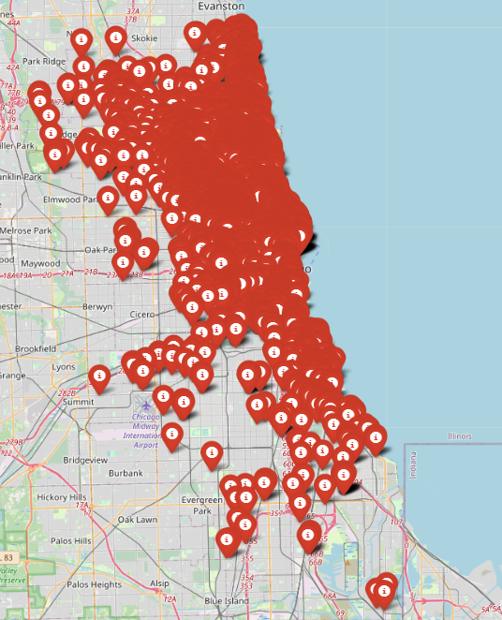
Problem Statement
A thorough analysis utilizing predictive models to project revenue for Airbnb superhost and host listings, offering actionable insights that highlight the benefits of achieving superhost status and delineating the pathway to becoming a superhost in the dynamic Airbnb marketplace
Growing Airbnb Market
Understanding Airbnb's revenue and superhost dynamics is key to host competitiveness and profit
13689
725
Unique Airbnb Host IDs
Unique Census Tracts
Host Differentiation
Differentiating superhost experiences, guiding hosts on where to enhance and invest
25845
74
Unique Airbnb Property IDs
Unique Property Type
Adapting to Consumer Preferences
Aligning host offerings with changing trends, boosting guest satisfaction and revenue
4
56
Unique Listing Types
Unique Zipcodes
Technology Integration in Hospitality
Highlights the need for tech and data analytics in improving personal and small hospitality businesses
518639119
271025271
Total Pop. In Census Tracts
Total Rev. of Census tracts

Slide 5
Current State vs Future State
Standardization Need
Disparities in Airbnb hosting call for unified standards
Maximized Earnings Approach
In-depth analysis of revenue drivers aids in financial optimization
Performance Standardization
Predictive analytics streamline hosting practices, narrowing performance gaps.
Knowledge Gap
Uncertainty in revenue generation and superhost criteria impacts host success
Strategic Hosting Improvements
Data-informed guidance sharpens hosting and revenue strategies
Clarity on Earnings and Status Models demystify factors affecting revenue and superhost attainment
Bridging the Gap
Experience Variability
Differing guest experiences and satisfaction levels affect host ratings and visibility
Guest Satisfaction Consistency
Analytics forecast guest needs, driving uniform positive experiences
Adaptive Hosting Strategies
Proactive adaptation to market and regulatory shifts based on study insights.
Tech Optimization
Incomplete use of available tech limits listing potential
Superhost Achievement Guide
Analytics provide a clear path to superhost status
Targeted Tech Adoption
Data-driven insights ensure hosts adopt tech that best boosts their listings

Slide 6
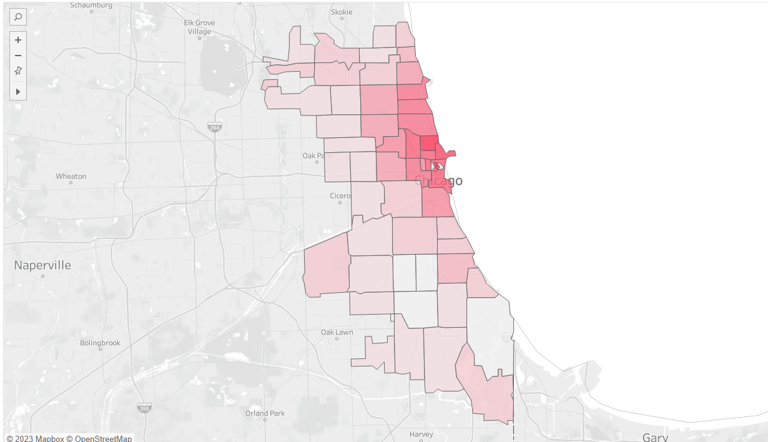
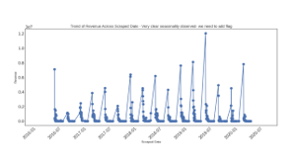
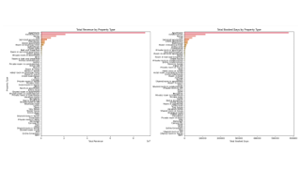
Decoding the Dataset: Core Elements and Statistics
Thematic breakdown
Host and Property Profiles
Identifiers, property types, and listing specifics
Seasonal Revenue Shifts
There are key revenue bursts in summer and Christmas
Financial and Booking Analysis
Revenue, nightly rates, booked days, and future reservations
Geographical Insights :
Chicago Downtown zip codes generates more revenue than other areas
Performance and Quality Indicators
Superhost status, ratings, reviews, and guest satisfaction metrics
Geographic and Demographic Insights
Location specifics and area demographics
Top Property Revenue Insights: Apartments, Condominiums, and Houses emerge as top earners .
Market Trends and Seasonality
Seasonal impacts on bookings, market dynamics, and competitive data
Operational Details
Listing features, operational aspects, and amenities
Notes:
Our dataset comprises a comprehensive collection of Airbnb listings from Chicago, featuring detailed host and property identifiers over various evaluation periods. It includes precise timestamps for each record, facilitating the analysis of trends and superhost status changes. The dataset offers a multifaceted view of hosting performance through metrics like ratings, reviews, and cancellations. It covers aspects such as property types, financials, geographical and demographic data, enabling in-depth geo-spatial and market analyses. Additionally, it provides insights into listing pricing, availability, and seasonal booking trends, essential for strategic planning in the dynamic short-term rental market. In the accommodation sector, apartments, condominiums, and houses stand out as top earners. Their appeal stems from offering abundant features, ample space, and privacy, which attract longer-term stays. This leads to high demand and occupancy rates, making them particularly lucrative investments In Chicago, downtown zip codes generate more revenue than other areas, with top zip codes in affluent, densely-packed business sectors and prime commercial locations leading the way. The combination of robust foot traffic, upscale real estate, and tourism in these areas fosters higher spending, resulting in superior revenue generation compared to other zip codes. The revenue for Airbnb hosts in Chicago sees a bump during summer and Christmas due to high tourist influx, attracted by favorable weather, festive events, and limited hotel availability. These peak seasons draw visitors for both leisure and business, increasing the demand for short-term rentals.

Slide 7



Data Cleaning
Data Preprocessing
Missing Values​
Address missing data by imputing with median values for numerical variables and modes for categorical variables
Encoding Categorical Variables
Leverage LightGBM's advanced handling of categorical variables.
Data Splitting
Only Census Tracts with 1 Million Revenue:
To focus the analysis on high-value areas
Special Characters Checks​
Screen the dataset for special characters that may indicate data entry errors or encoding issues, ensuring textual data integrity
Dimensionality Reduction
Prune the dataset by removing features that do not contribute to the model's predictive power
Duplicates Removal​
Check performed to ensure elimination of duplicate entries to prevent data redundancy
Time Series Considerations
Panel Data with Seasonality: Incorporate dummy variables to represent seasonal effects and include lagged columns to capture time-dependent patterns within the panel data structure.
Outliers Detection​
Identify statistical anomalies through outlier detection methods​
Feature Engineering
Temporal Features: Derive temporal attributes from date-time information, capturing essential dynamics like seasonality and trends.
Aggregating Features: Consolidate data points over the superhost_period_all to create summarized metrics that reflect longer-term patterns and host performance.
Standardization​
Normalize data formats and conventions across the dataset to ensure consistency​

Slide 8
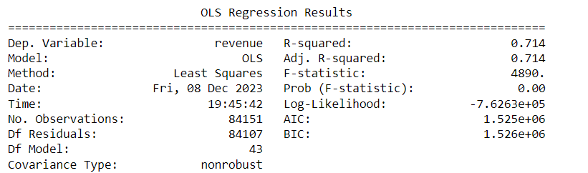
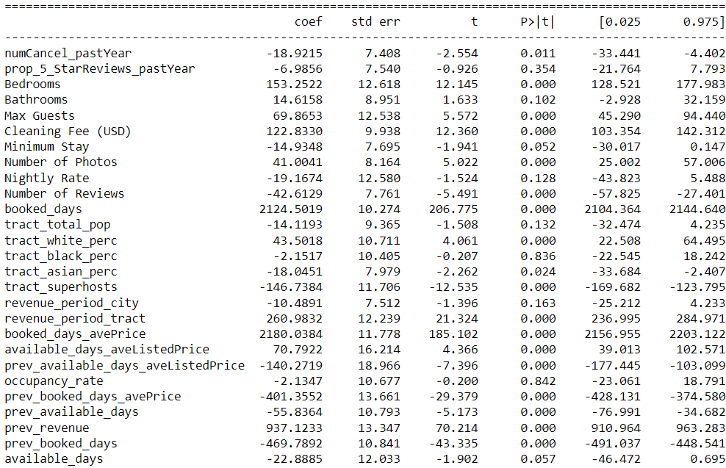
The Regression model
Revenue Prediction for Superhost Listings
Positive Drivers | Negative Drivers
Booked_days | Prev_booked_days
Booked_days_avePrice | Minimum_Stay
Cleaning Fee(USD) | prev_available_days_aveListedPrice
Bedrooms | Number of Reviews
Prev_revenue | prop_5_StarReviews_pastYear
Predicts the revenue for listings managed by Airbnb superhosts to understand the revenue potential of properties under the management of superhosts
Regression Model

Slide 9
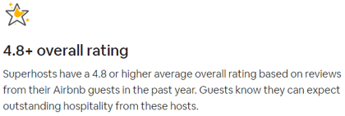
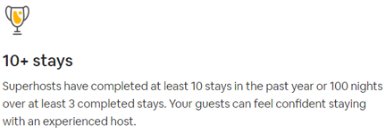
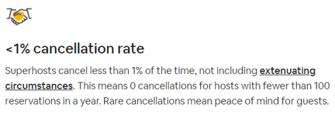
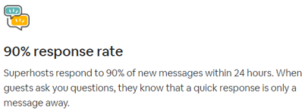
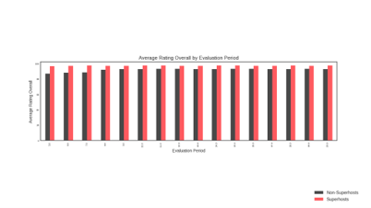
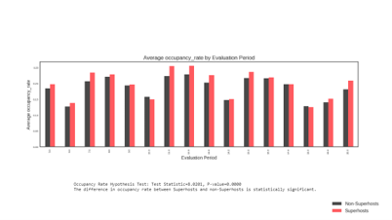
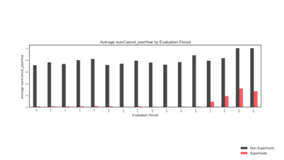
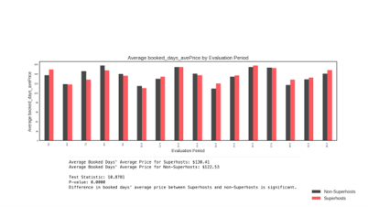
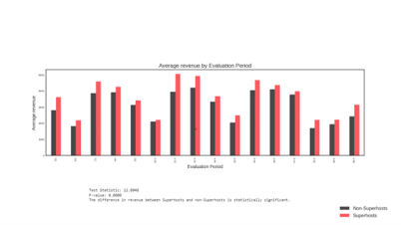
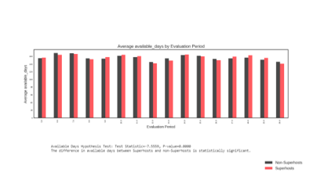
Host Behaviour Shifts
Let’s look at the history of Hosts vs Superhosts dynamics

Slide 10
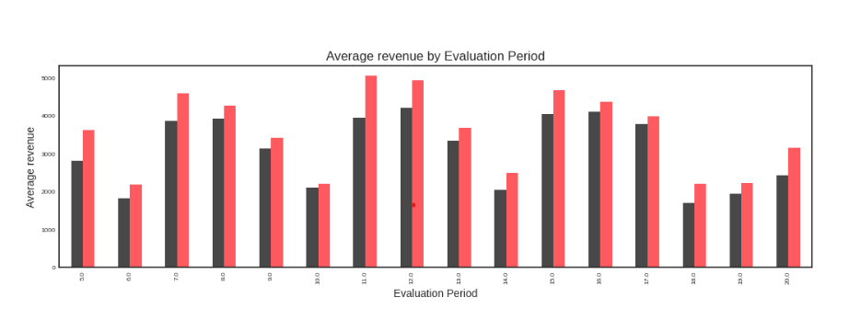


Slide 11
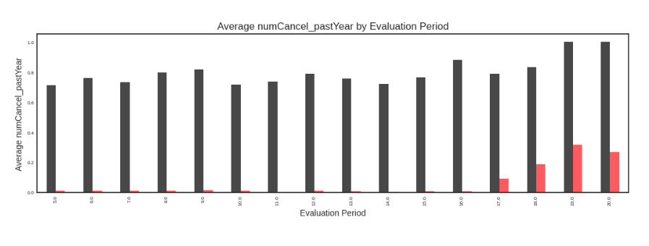

Slide 12
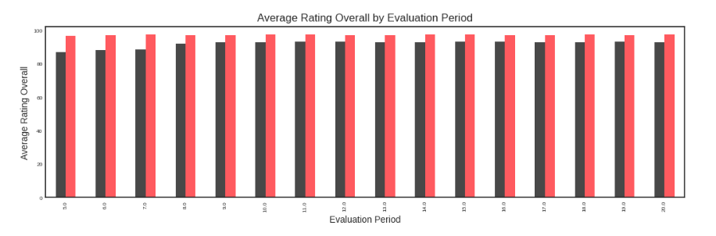

Slide 13
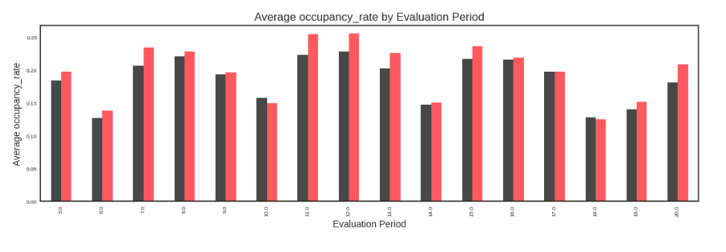

Slide 14
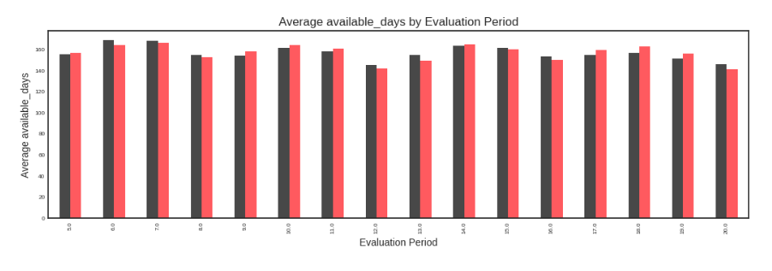

Slide 15
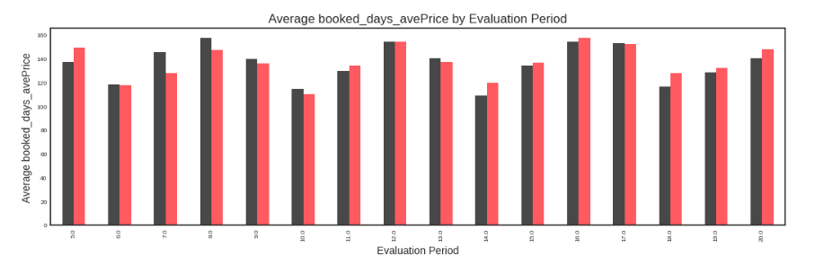
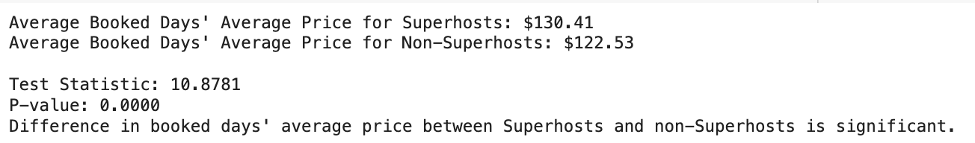

Slide 16
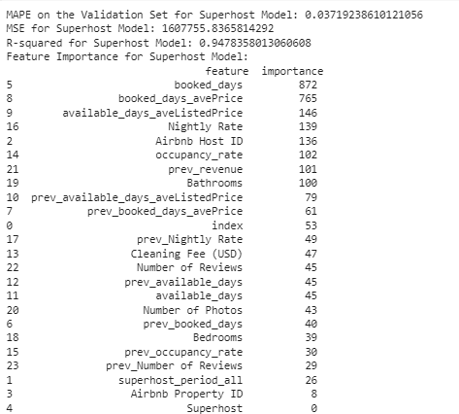
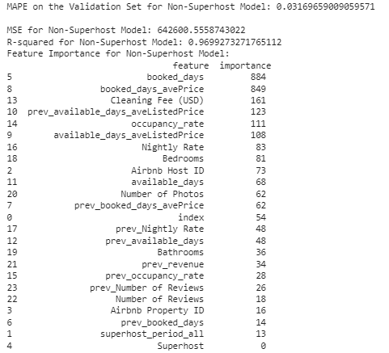

Modeling Metrics: Model Design and Strengths
Revenue Prediction for Superhost Listings
Revenue Prediction for Non superhost Listings
Predicts the revenue for listings managed by Airbnb superhosts to understand the revenue potential of properties under the management of superhosts
Predicting revenue of properties managed by non-superhosts This allows for a direct comparison with the superhost model to assess the impact of the superhost status on revenue generation.
Gradient boost Regression Model 1
Gradient boost Regression Model 2

Slide 17
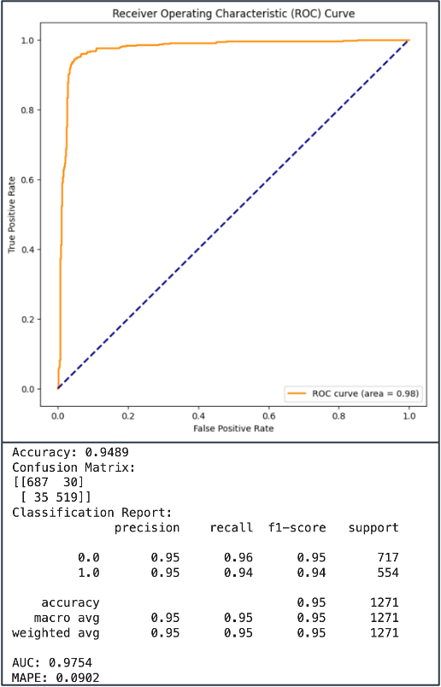

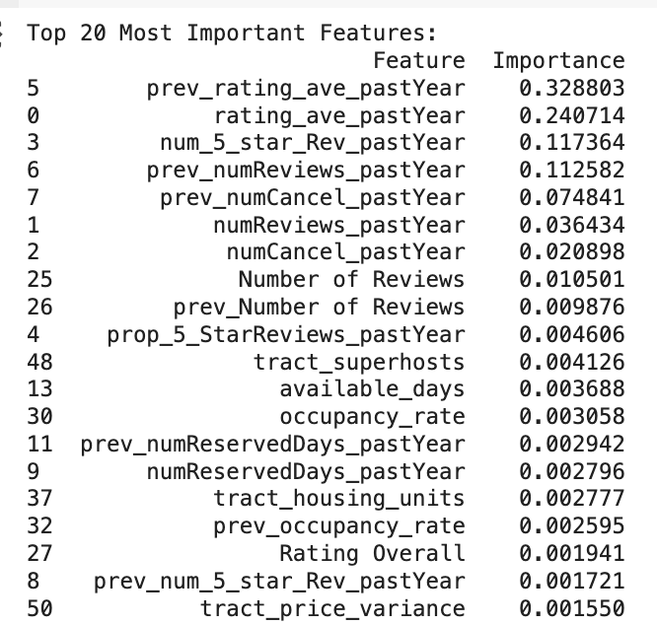
Superhost Status Prediction
A statistical model crafted to calculate the chances of an Airbnb host gaining or keeping superhost status, utilizing analysis of past performance indicators pertinent to Airbnb's superhost criteria.
The superhost status prediction model will provide strategic value by identifying the key performance indicators that most significantly influence a host's probability of achieving superhost status. This model will serve as a tool for hosts to gauge their current performance against superhost standards and to pinpoint areas requiring improvement.
Gradient boost Model 3

Slide 18
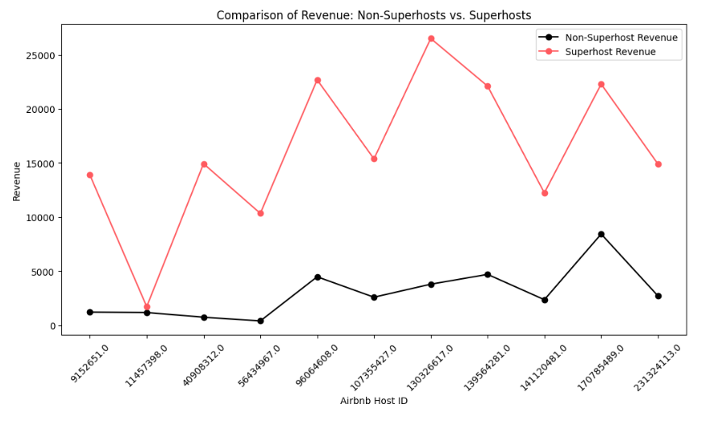
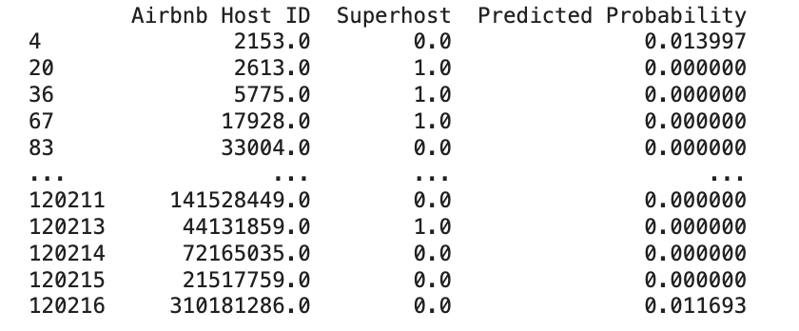
The Financial Impact of Achieving Superhost Status
Revenue Analysis Overview
Focused on 72 census tracts with over $1 million in revenue
Earning Potential for Hosts
20% of hosts in these tracts have the potential to increase earnings by an average of $2,074.87 as superhosts
Underperformers’ Revenue Increase
Superhosts earn at least $500 (based on random sample) more than hosts at the lowest differential, showcasing consistent financial benefits
Chance of Advancement
Hosts with the lowest revenue lift have a 50% baseline chance of becoming superhosts, which improves with targeted enhancements
Strategic Financial Benefits
Visual data supports the financial upside of superhost status, encouraging hosts to make necessary improvements to advance

Slide 19

Recommendations
Easy Level: These are tasks that can be implemented quickly and with minimal effort:
Enhance Listing Quality:
Take and upload more high-quality photos of the property.
Update listing descriptions regularly with detailed and accurate information.
Encourage Guest Reviews:
Promptly ask guests for reviews after their stay.
Respond to all reviews, both positive and negative, in a professional manner.
Moderate Level: These tasks require more time and effort but are crucial for long-term success:
Guest Experience Enhancement:
Actively seek and apply guest feedback to improve the service.
Offer amenities or services that stand out (e.g., free Wi-Fi, welcome gifts).
Optimize Online Presence:
Use social media or local tourism websites to promote the listing.
Stay active on the Airbnb platform to maintain high visibility.
Hard Level: These are long-term strategies that involve significant effort or investment:
Property Improvements:
Consider renovations or redecorations to improve guest appeal and comfort.
Increase Bookings and Reserved Days:
Develop and implement strategies to increase the number of reservations and length of stays.
Offer discounts for longer bookings or off-season stays.
Minimize Cancellations:
Establish a reliable and flexible hosting plan to reduce the number of cancellations.

Slide 20
Thank You

Slide 21
Appendix

Slide 22
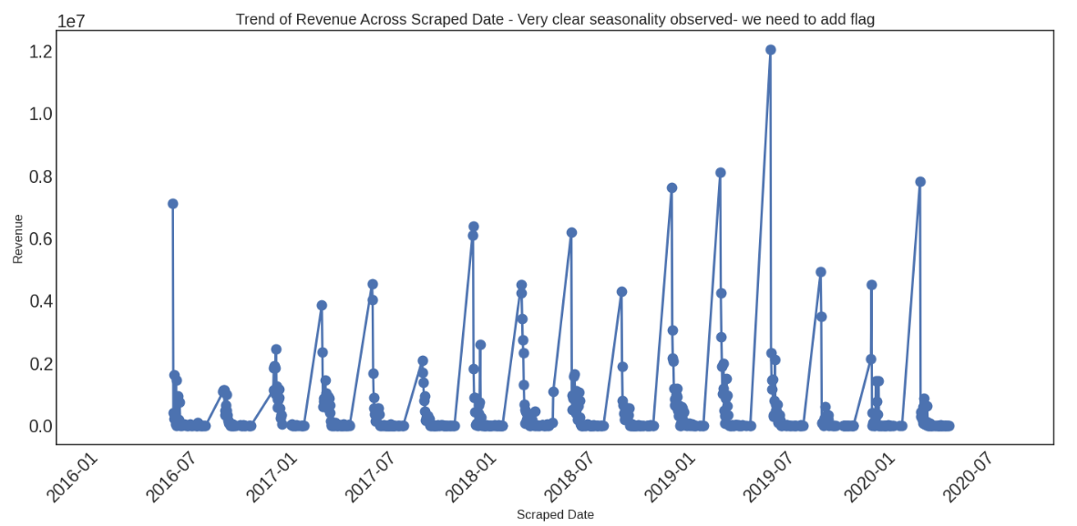

Slide 23
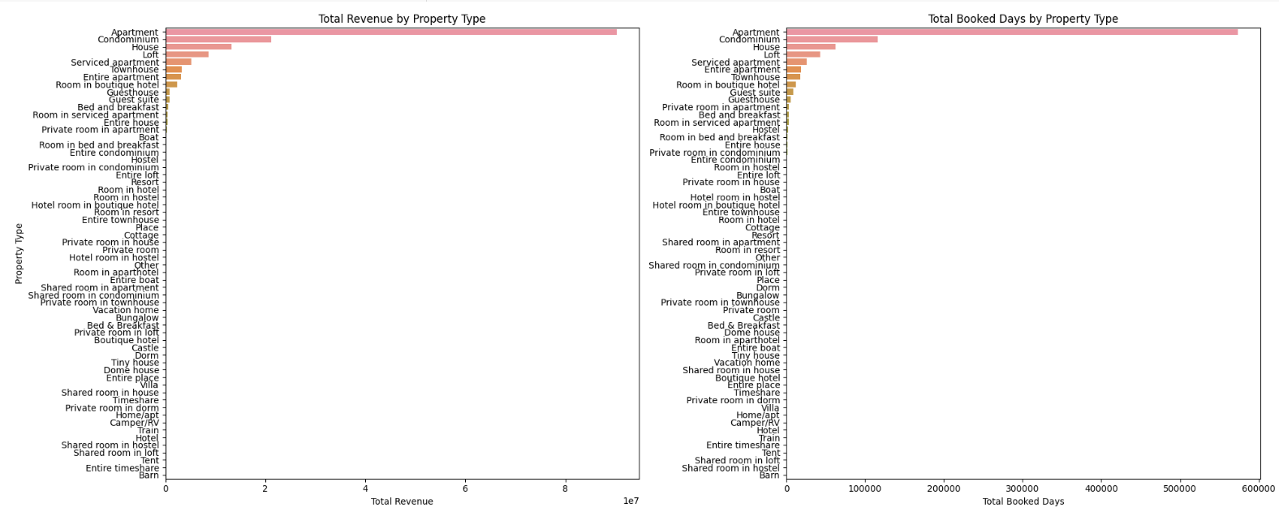

Slide 24






Recommendations
Focus on maintaining high guest ratings through exceptional service quality, cleanliness, and personalized guest experiences and better amenities.
Leverage guest reviews by showcasing positive feedback, engaging with all reviews for continuous improvement, and using insights for service enhancement.
Optimize available days by aligning with peak demand and adjusting minimum stay requirements to balance demand and workload
Manage cancellations effectively by adopting a balanced policy and ensuring reliable booking management to maintain trust and visibility.
Implement dynamic pricing strategies to adjust rates based on market demand and seasonality, and stay competitive with regular analysis of similar listings.

